Slide 1
MapReduce: Past and Current Developments
An Analysis by
John Tran
CS159
Notes:
Hi guys, my name is John and my topic of research for parallel processing deals with MapReduce. It’s related to the presentation of <X> who showcased Apache Hadoop, but mine will be more general
I’m going to reiterate on some elements of MapReduce & Apache Hadoop, but it will only be on the fundamental details necessary to understand new concepts

Slide 2
Overview
What is MapReduce – Basic Fundamentals
History of MapReduce – Why MapReduce Came to Be
Current Developments of MapReduce – Where is MapReduce Going
Hadoop Ecosystem – Pushing MapReduce/Big Data/Distributed Systems Forward
Apache Hadoop vs Apache Spark
Notes:
1) First I’m going to cover what is MapReduce – Fundamentals on the phases of how it processes data
2) Then the history of MapReduce. How it came to be realized as an approach to data and software challenges, and how big institutions leveraged MapReduce to solve their big data challenges
3) Then on what is the trajectory of MapReduce for the future. Is it an obsolete technology?
4) Afterwards I’ll be discussing the Hadoop Ecosystem. The Hadoop Ecosystem is in a sense the main force driving the popularity of MapReduce and distributed systems as a big data solution
Finally a small coding example of Apache Hadoop vs Apache Spark

Slide 3
What is MapReduce – In General
MapReduce is an parallel and distributed approach to dealing with big data
Generalized map & reduce - fundamental
map procedure: Given a function, applies logic on each element in a list and return that list
reduce procedure: Given a function, applies logic to aggregate a list into a return value
Example
Notes:
MapReduce is a parallel distributed approach to dealing with big data.
But before you can understand how MapReduce connects to parallel processing, you need to understand the core aspects of it
Which is the map and reduce procedures – should remind you of CS152 if you’ve taken it because it’s origins is in functional programming
Map: Given the logic of a function, maps a list into a new list
Square each element, add 1 to each element, first 3 characters of each string, extract properties of objects
Reduce: Given the logic of a function, reduces a list into a final value
Find out what the average, max, minimum of a list
Below is a an example in JavaScript. Square and sum functions are used to calculate the sum of squares

Slide 4
What is MapReduce - Clusters
MapReduce is an parallel and distributed approach to dealing with big data.
Macroscopic trend
MapReduce on a Cluster - Stages
Split: Input is divided into N splits, one for each node to apply map logic
Map: For each split, a node processes all the values and emits <KEY, VALUE> pairs
Shuffle (Merge & Group) : Pairs with the same KEY are grouped together into M partitions
Reduce: Grouped <KEY, VALUE> pairs are applied reduce logic and an output is given
Shuffle
Reduce
Map
Output
Split
Input
Notes:
Like I said before, MapReduce is a parallel and and distributed approach to handling big data
It is a macroscopic trend because it utilizes clusters of computers to do computation
Instead of scaling up the capabilities of a single computer, it scales out to leverage multiple computing units
Although the name MapReduce contains the two functions I explained before, it differs in some aspects to those two functions because it must consider how the map and reduce procedures can be leveraged to achieve parallelism
Thus there are some additional stages
Divide: Separates the data set into multiple splits
Map: For each partition, a node in the cluster processes it and emits key:value pairs
Shuffle: Moves results from mappers to reducers partitions – Where each key:value pair goes goes depends on the key because keys are grouped together
Reduce: Each partition is reduced into a single output value
Below here you see the hello world equivalent of MapReduce which is wordcount.
The input text is divided
The splits are processed by a node in the cluster, and the key value pairs are mapped and shuffle into partitions here
Each partition is processed by a node which reduces, in this case counts each, the total number of times a word appears
Finally the output is written

Slide 5
MapReduce – A History
Notes:
Hopefully I helped you all review how MapReduce works so now I will talk about how MapReduce came to be prominent as a big data solution

Slide 6
A Solution to Big Data
Big Data: Data sets that are too complicated to be handled with conventional data-processing techniques
MapReduce developed as a solution to big data problems
The Three V’s of Big Data
Volume: The size of data is too large
MB → GB → TB → PB → EB
Velocity: The rate of data production is too rapid
Batch → Periodic → Real-time streaming
Variety: The structure of data is too chaotic
Table → Relational Database → Photo, Web, Audio → Video, Social Media, Human Behavior
Notes:
MapReduce came about as a solution to handling big data.
Big Data: Describes data that is too complex to be handled by conventional data-processing techniques.
In this case, conventional techniques is in context of what was widespread at the time, which in the period of the late 1990s and early 2000s
During this time, became more evident that conventional data-processing solutions at the time was not completely adequate in dealing with big data.
The Three V’s are terms often used to qualify when data is actually big data
Volume
Facebook needs to store the content generated 2.1 billion unique users on Facebook every month in perpetuality
Velocity
Twitter needs to handle hundreds of thousands of tweets coming in per minute
Variety
Google gmail auto-sorts different emails for each of its user. Emails have a variety of characteristics - who's the sender, destination, time stamp, attachments, etc.
https://news.usc.edu/88075/how-does-facebook-store-billions-of-photos/

Slide 7
Before MapReduce – Relational Database Management Systems (1970’s – 2004)
Typical Relation Database Structure
Relational Model
Notes:
Before the MapReduce paradigm, data was typically stored in relational databases
This is your typical SELECT * FROM table-esque queries
Data is organized in rows (represents records) and columns (represents properties of that record)
Mainly in this period it was used by businesses, academia, & government to do batch analysis of data
https://upload.wikimedia.org/wikipedia/commons/5/57/RDBMS_structure.png

Slide 8
Problems with Relational Database?
1) Data must conform to the RDBMS’s schema
2) Modifications to the schema can be difficult to adapt to
3) Expensive to scale
Must scale up
Can’t scale out
1983
1989
1995
1997
"RDBMSs can be beaten by more than an order of magnitude on the standard OLTP benchmark … They should be considered as legacy technology more than a quarter of a century in age, for which a complete redesign and re-architecting is the appropriate next step.”
- Michael Stonebraker (Co-founder of Postgres) in the “The End of An Architectural Era” (2007)
Notes:
However, as the size and use cases of data grew, it limitations became more and more evident
The first is the relational model’s restriction.
All data stored in RDBMS must fit into a relational schema
Recall the 3rd V - Variety
Modifications to schema can be difficult to adapt to and for
Database administrators and users must contend with how such changes will affect workflow
Expensive to scale up
At the time, cluster/cloud computing was not prominent as it is today.
To improve storage or speed, usually needed to add more disk drives, CPU power, ram, etc.
Many database solutions were propriety, and users needed to pay more to achieve this
All these things add up and it was at this point that many realized, at least implicitly, that current solutions was approaching suboptimal cost/performance on the business technology curve
Here’s a quote from Michael Stonebraker in an academic MIT paper. Basically it said the traditional basic RDBMS systems are becoming obsolete, and that new methodologies must replace it
http://cs-www.cs.yale.edu/homes/dna/papers/vldb07hstore.pdf

Slide 9
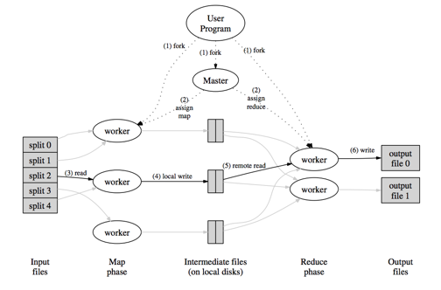
Rise of MapReduce – Google File System (2003 – 2004)
MapReduce: Simplified Data Processing on Large Clusters (Dean & Ghemawat, 2004)
Google File System & MapReduce: Google’s implementation of MapReduce ran on their proprietary distributed filesystem
Set conventions e.g. master & worker nodes
Benefits realized
Speed – Parallelism + locality of reference: "When running large MapReduce operations on a significant fraction of the workers in a cluster, most input data is read locally and consumes no network bandwidth.”
via Distributed File Systems
Fault tolerance: Data replication across nodes
Abstraction: MapReduce can be utilized without heavy learning curve
Notes:
In 2004, Google engineers showcased the first practical instance of MapReduce in a whitepaper written by Jeff Dean and Sanjay Gemawat
It was so useful that it’s general architecture, was kept and built upon by later projects
For example, the idea of master & worker nodes in the distributed system. This is also the same in the Hadoop file system
worker nodes: Composes the majority of cluster. Holds data and runs computations
master node: Oversees how data is stored in the file system. Coordinates parallel processing of data
A new point
As you will see later, MapReduce tasks typically runs on distributed file systems
MapReduce framework was implemented on top of this file system
Locality of reference: A key feature of what makes MapReduce so fast
The input data is already pre-loaded and distributed throughout the cluster. There is no expensive network or disk write activity
Data is not sent to the client machine, client machine sends code to run on cluster
Fault tolerance: Because there is a distributed system, data can be replicated across nodes. Failed nodes or MapReduce tasks can be re-replicated and picked up by another worker node
Abstraction: If you’re just writing the MapReduce program, you don’t necessarily need to know the structure of the cluster (for example what’s a master node, what’s a worker node etc, how the network works, etc.) Whatever framework you use will handle this (Hadoop)

Slide 10
Apache Hadoop (2005 - Present)
Apache Hadoop: Free open-source software framework for distributed storage and MapReduce processing
Grew out of Apache Nutch, a web crawling framework
Hadoop Distributed File System (HDFS): Distributed file system
Hadoop YARN (Yet Another Resource Negotiator): Driver for Hadoop
Hadoop MapReduce: Project’s implementation of the MapReduce approach
Collaborative effort and growth
Facebook: Introduced a fair MapReduce job scheduler
June 2010: Facebook - 2,300 clusters & 40 petabytes
Yahoo: First adopter and creator of YARN
June 2011: 42,000-node Hadoop cluster & 100’s of petabytes
AliBaba, AWS, eBay, Hulu, Microsoft, IBM, LinkedIn, Spotify, Twitter
Notes:
Apache Hutch: A web crawling framework from the Apache Software Foundation.
Hadoop was a utility sub project that contained a MapReduce implementation and a distributed file system (like google)
Founders say Hadoop was inspired by GFS and their MapReduce
Components: Divided because you don’t necessarily need all. Depends on what you’re doing. Allows flexibility for application programmers
Can have Hadoop MapReduce run on Amazon S3 or Microsoft Azure’s Blob filesystem
Can have other MapReduce designs run on Hadoop file system (shown later)
Hadoop Distributed File System
Analogous to Google File System. Distributes the data so that Hadoop can perform
Hadoop YARN: Resource management and job scheduling, node monitoring, into into separate daemons. Driver for the MapReduce program
Hadoop MapReduce: Hadoop’s implementation of MapReduce
Hadoop is under the Apache license so it’s free and open-source. As a result, a bunch of companies not only utilized it but also built and improved it

Slide 11
MapReduce – Current and Future Developments
Notes:
2004 – 2018 is a long period of time. MapReduce became much more mature and widespread and along with related toolsets

Slide 12
Drawbacks of Hadoop
No relational model: Inputs are taken as a file
Only batch processing
Not flexible: Need to frame problem and code into a MapReduce perspective.
Boilerplate & configuration
Arguably obsolete
Notes:
However, the limitations of Hadoop & MapReduce in general became more and more prominent
No relational model: A relational structure definitely has its use cases in association properties of records. You lose this with MapReduce
Hadoop only has batch processing
No solution for the second V of big data (velocity)
Not Flexible
This isn’t necessarily easy or efficient for every use problem
These last two points are opinions from myself but a lot the Hadoop community has the same gripes
Boilerplate & configuration
Configuration to set up a cluster is difficult for newcomer
Docs aren’t necessarily the best I’ve read
The hard part was making sure the platform was working on a low-powered cluster of machines. Personally, I found this to be harder than the programming itself
Arguably obsolete. Many tools have spawned off of Hadoop and MapReduce to remedy some of the problems people were having with it, so some might say there isn’t a reason to really use Hadoop

Slide 13
Hadoop Ecosystem
Hadoop Ecosystem: Suite of libraries/frameworks/tools that have spawned off the Hadoop model
Apache Hive: RDBMS-esque data warehouse built on top Hadoop. Abstracts MapReduce code away from application programmers and gives a SQL-like API.
Apache ZooKeeper: Centralized service to maintain configuration, synchronization, and other group services in distributed systems.
Apache Cassandra, Apache Kafka, Apache Flume, Apache Drill, Apache Mahout, Apache HBase
Notes:
Some people even say that Hadoop is dead. But from my research, it’s not that Hadoop is necessarily dead, but rather Hadoop and MapReduce has evolved into a more general place
A lot of tools were spawned off of it. As a collective these tools are often called the "Hadoop Ecosystem"
These tools were created to extend, enhance, or compliment HDFS, Yarn, and Hadoop MapReduce
So now, people don’t necessarily have to restrict themselves to the limitations of Hadoop or MapReduce
There’s a lot of tools that directly build on top of Hadoop or have been inspired by Hadoop’s big data approach.
Like Hadoop, there’s a lot of big tech giants that both use and contribute to the ecosystem, given the free open-source nature of Apache and the first mover’s advantage that Hadoop had.
A lot of frameworks, like Spark, Apache Mahout, Google Dataflow use MapReduce for the underlying computation, but the API given to the application programmer suits their need more

Slide 14
Apache Spark
“Successor” to Apache Hadoop Framework
All-in-one Tooling
MapReduce, machine learning, batch, streaming …
Compatible with HDFS/Yarn and more
Spark MapReduce > Hadoop’s MapReduce
In memory
DAG optimization – minimizes shuffling
Simpler API
Less boilerplate
More expressive
Languages: Scala, Java, Python, & R
Notes:
Apache Spark: Another Apache top-level project that has the same MapReduce functionality has Hadoop + more
It’s faster than Hadoop
Has more tools than Hadoop for not just batch but also streaming
Key feature: Speed
In memory processing
Spark processes data in memory
Hadoop, and after map or reduce operations, data is persisted onto the disk
It’s better than Hadoop because all data is
More robust
More tooling

Slide 15
Hadoop MR vs Spark MR Analysis
Goal: Discover how Spark MapReduce performs against Hadoop MapReduce
Platform: Amazon Web Services EC2
Nodes in Cluster: 4
1 vCPU
1 GB memory
8 GB Storage
Hadoop File System & Hadoop YARN
Task: Read 3,441,197 Spotify songs (369 MB) from a .csv, then show artists by how many plays they have.
Notes:
Deployed on AWS
Dataset wasn’t entirely trivial since it was sizeable such that if I ran the same configurations on a one node cluster the program would fail for lack of memory

Slide 16
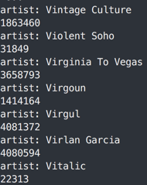
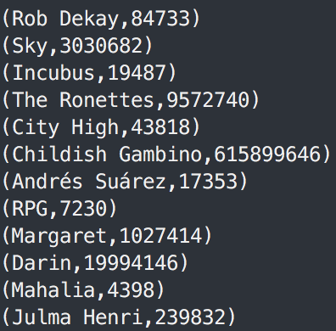
Task Workflow
1) Map: For each 3 input splits, the 3 worker nodes reads each song info and maps each input to a key:value pair of <ARTIST, PLAYCOUNT>
2) Shuffle: key:value pairs are sorted and pairs of the same ARTIST are sent to the same partition
3) Reduce: The 3 worker nodes reduce the partitions and output <ARTIST, TOTAL_PLAYCOUNT>
Hadoop Output
Spark Output

Slide 17
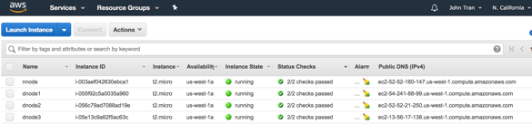
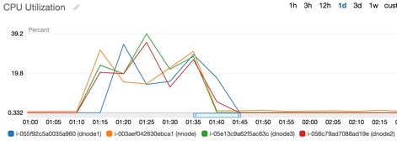
AWS Console
Schema & Records
YARN Web UI
CPU Utilization

Slide 18
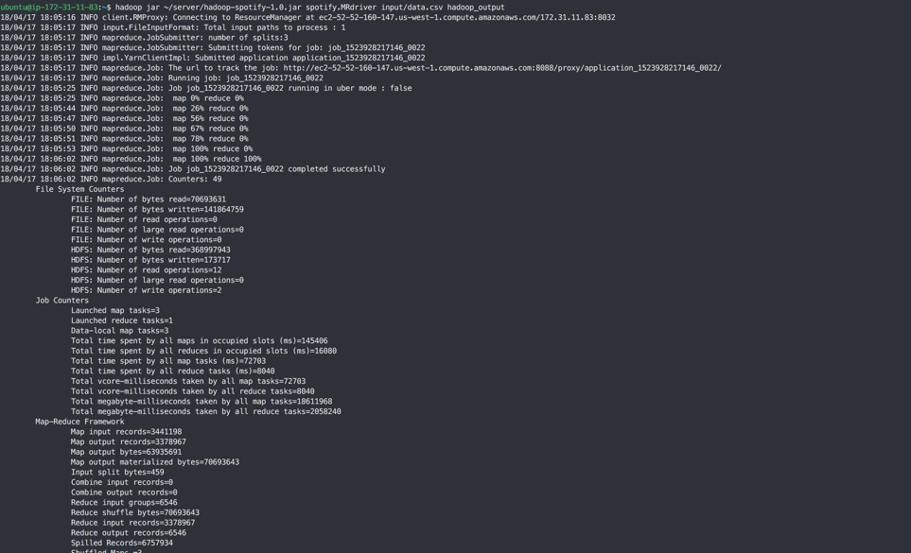

Slide 19
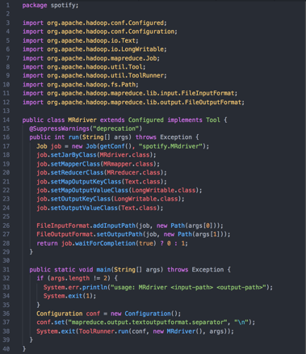

Setup Code
Hadoop
Spark

Slide 20
Mapper Code
Hadoop
Spark

Slide 21
Reducer Code
Hadoop
Spark
Notes:
In the end, much less code overall

Slide 23
Conclusions
MapReduce was created as a solution to big data problems
Prior tech e.g. monolithic systems, RDBMSs was not sufficient
Google: Whitepaper showed how MapReduce + Distributed File System can be used to efficiently process big data
Apache Hadoop: Pushed MapReduce approach to the mainstream
YARN (resource manager), HDFS (Distributed File System), Hadoop MapReduce
Hadoop Ecosystem: Many tools spawned off to extend, enhance, and/or compliment Hadoop
Ubiquitous in big data solutions
Future:
MapReduce as an programming model?
MapReduce legacy?
Notes:
Future
As the inherent limitations of MapReduce became more and more pronounced, it wasn’t seen as a super huge programming paradigm shift in the nature of procedural or OOP
A lot of projects, even Hadoop Ecosystem projects, have moved away from MapReduce in its API, although it still is the underlying engine of a lot of projects
MapReduce legacy
Programming model? Perhaps it’s not the definitive solution to every big data solution, but it was shown to be a possible solution that can be leveraged given the right situation
Legacy:
Definitely popularized distributed systems * fault tolerance. Are fundamental to cloud platforms which virtually all large tech companies utilize today.
Because Hadoop was so transformative in the world of big data, it spawned an entire ecosystem of tools to handle things that were difficult to do in Hadoop or MapReduce

Slide 24
References
https://github.com/jooohhn/cs159-mapreduce
https://research.google.com/archive/mapreduce.html
https://research.google.com/archive/gfs.html
https://hadoop.apache.org/
https://spark.apache.org/
https://www.kaggle.com/edumucelli/spotifys-worldwide-daily-song-ranking
http://cs-www.cs.yale.edu/homes/dna/papers/vldb07hstore.pdf

